Slide 1
Presentation on Formatting & Char of Good RD
Presented by:
Shiva Kumar Shrestha (660335)
Khwopa Engineering College

Slide 2
A report is typically made up of three main divisions:
Preliminary,
Body of report &
Supplementary

Slide 3
1. Preliminary Section
Title Page
Acceptance Page
Acknowledgment
Table of Contents
List of Tables (if any)
List of Figures (if any)
Abstract

Slide 4
Title - Be specific & make sure this is clear and indicates exactly what you are
Researching.
Acceptance Page - Acceptance of Supervisor, HOD, External Examiner etc.
Acknowledgment - Include only if special help was received from an individual or group.
Table of Contents - List all sections, sub headings, tables/graphs, appendices and
give page numbers for each.
List of Tables - refer to all tables within the report.
List of Figures - refer to all other items (graphs, pictures, drawings, maps, etc.)
Abstract - Summarizes the report including the hypotheses, procedures, and major findings.

Slide 5
2. Body of report
Introduction
Literature Review
Methodology
Results & Discussion
Conclusion & Recommendation

Slide 6
Body of report Introduction:
Purpose of your report,
Objective of research to be clearly mentioned,
Background information may include a brief review of the literature already available on the topic so that you are able to ‘place’ your research in the field.
Some brief details of your methods and an outline of the structure of the report.

Slide 7
Body of report Literature Review:
Prevents duplicity,
May be useful to do a chronological format where you discuss from the earliest to the latest research, placing your research appropriately in the chronology.
You will need to state where your research fits.

Slide 8
Body of report Methodology :
Why you used that particular method?
Clear outline of what methodology you used in your research i.e. what you did and how you did it.
It is usually written in a ‘passive’ voice.
Clearly reference any material you have used from other sources.

Slide 9
Body of report Results & Discussion:
Results - This is where you indicate what you found in your research. You give
the results of your research, but do not interpret them.
Discussion - This is where you discuss the relevance of your results and how your findings fit with other research in the area. It will relate back to your literature review and your introductory thesis statement.

Slide 10
Body of report Conclusion & Recommendation:
Conclusion - This is a summary of the most significant results/findings.
Recommendation - This includes suggestions for what needs to be done as a
result of your findings. Recommendations are usually listed in order of priority.

Slide 11
3. Supplementary
References or Bibliography
Appendices

Slide 12
Supplementary References or Bibliography:
References or Bibliography - This includes all references used in your report or referred to for background information. This must be done using the referencing convention specified by your lecturer/tutor.

Slide 13
Supplementary Appendices:
Appendices - These should add extra information to the report. If you include appendices they must be referred to in the body of the report and must have a clear purpose for being included. Each appendix must be named and numbered.

Slide 14
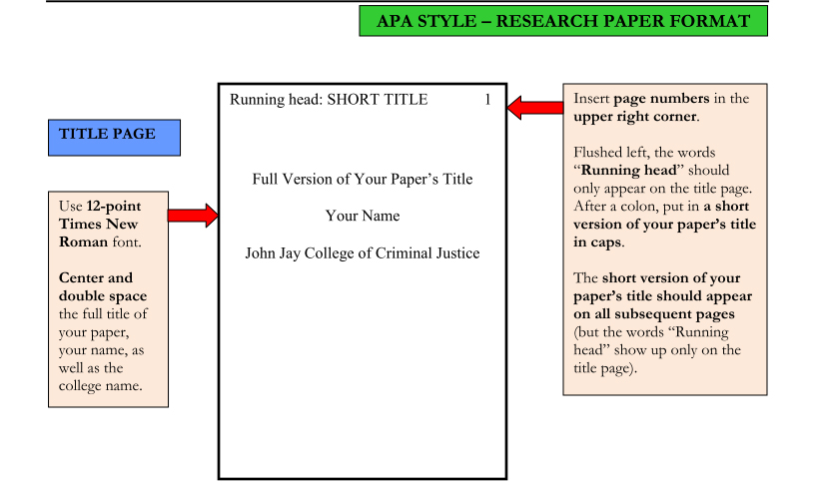
APA (American Psychological Association) style

Slide 15
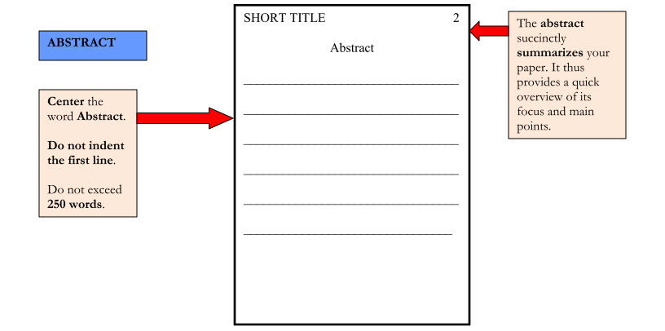
APA (American Psychological Association) style Continued…

Slide 16
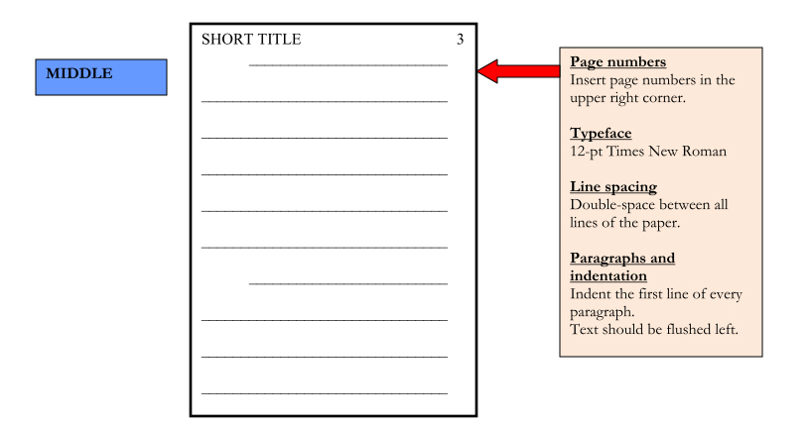
APA (American Psychological Association) style Continued…

Slide 17
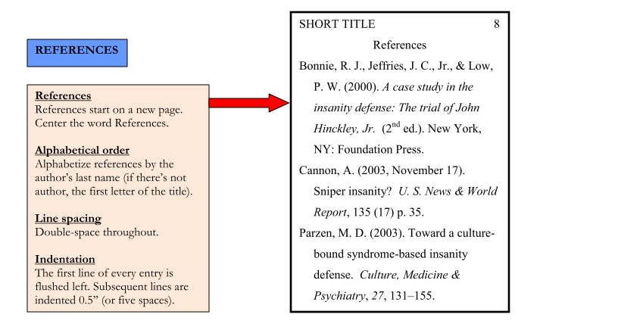
APA (American Psychological Association) style Continued…

Slide 18
Characteristics of good research design
The Research Topic
Relationship to Previous Research
Experimental Design
Bias and Ethics

Slide 19
The Research Topic - A researcher may begin a research project with a broad question Relationship to Previous Research - A thorough review of previous literature on the topic provides essential insights for the researcher. The research to be conducted must not be identical to research that has already been done.
Experimental Design - Experimental design begins at the end, by deciding what data needs to be collected from the experiment. The researcher decides what qualities to measure, what measurements to use and how to analyze the data.
Bias and Ethics - Scientific research must avoid both the personal bias of researchers and bias in the design of experiments. Researchers should remain detached from the results of experiments and avoid using biased language in reports. To avoid bias in experiments, researchers should clearly state their assumptions, thoroughly document the procedures and systematically perform them. Ethical considerations are important for experiments that use human or animal subjects.

Slide 20
Thank You

